Slide 1
DEQUE
Sabrian Jufenlindo (1548517)
Data Structures and Algorithms (Deque)

Slide 2
AGENDA
Introduction
Primary goals
Strength
Weakness
Real World Application
Deque Structure
Code Implementation
Summary

Slide 3
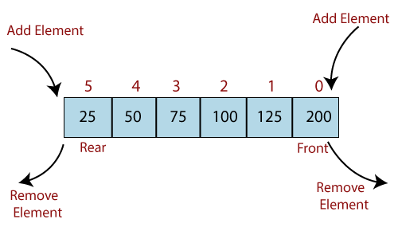
INTRODUCTION
A double-ended queue is a data structure that generalizes a queue. Deque has two ends, front and rear, where the items remain positioned in the data structure. Deque is different from queue as it has an unrestrictive nature of adding and removing data from the collection. Items can be added from the collection front or the rear. Likewise, item can also be removed from its front or rear.

Slide 4
PRIMARY GOALS
Used as stack and queue
A-steal algorithm in multiprocessor scheduling
Notes:
As stack can add and remove elements from both end, this data structure is not restricted by FIFO(First in first out) rule as in a stack or LIFO(Last in first out) rule as in queue
Assuming we have 2 processors and each processor has a process to execute. Each processor has been assigned with a process or a job, and each process contains multiple threats. Each process maintains a deque that consists of threads that are ready to be executed. The processor executes a process, and if a process creates a child process then that process will be inserted at the front of the deque of the parent process. Suppose the processor P₂ has completed the execution of all its threads then it “steals” the thread from the rear end of the processor P₁ and adds to the front end of the processor P₂. The processor P₂ will take the thread from the front end; therefore, the deletion takes from both the ends, i.e., front and rear end

Slide 5
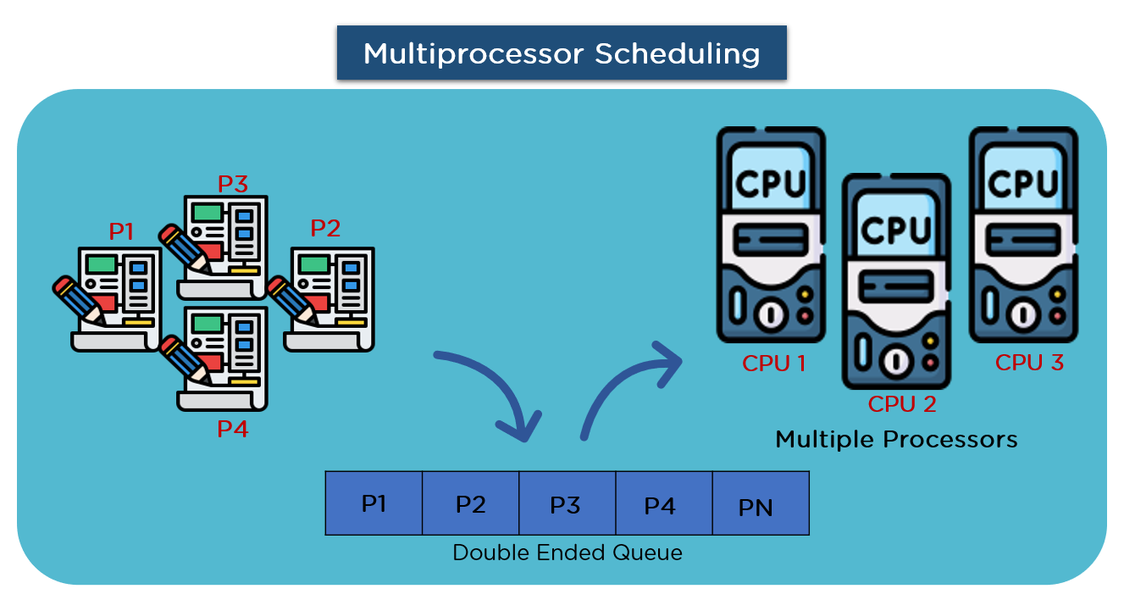
Notes:
Assuming we have 2 processors and each processor has a process to execute. Each processor has been assigned with a process or a job, and each process contains multiple threats. Each process maintains a deque that consists of threads that are ready to be executed. The processor executes a process, and if a process creates a child process then that process will be inserted at the front of the deque of the parent process. Suppose the processor P₂ has completed the execution of all its threads then it “steals” the thread from the rear end of the processor P₁ and adds to the front end of the processor P₂. The processor P₂ will take the thread from the front end; therefore, the deletion takes from both the ends, i.e., front and rear end

Slide 6
STRENGTH
Uses less overall memory compared to an array
Deque automatically frees allocated memory when its size drops lows enough.
The time complexity of all deque of operations is O(1).
Notes:
It uses less memory as the deque is dynamically sized, means its size can keep growing without any predetermined size
As I mentioned above, its size on the memory will shrink depending on the amount of element it has
All operation just need to be executed once

Slide 7
WEAKNESS
Iterating random indexes in deque has a complexity of O(n) as it needs to iterate each element until it gets to the element of specified index.
Concurrent access is not allowed

Slide 8



Real world example
Web Browser History
Software Undo Operations
Multithreading Processor
Notes:
Recently visited URLs are added to the front of the deque and the URL at the back of the deque is removed after some specified number of insertions at the front.
application’s list of undo operations.
commonly used in a multi-threading processor.

Slide 9
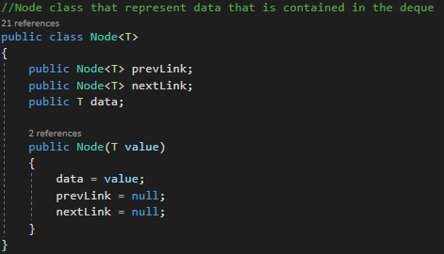
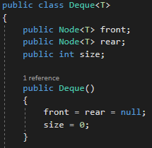
Deque Structure

Slide 10

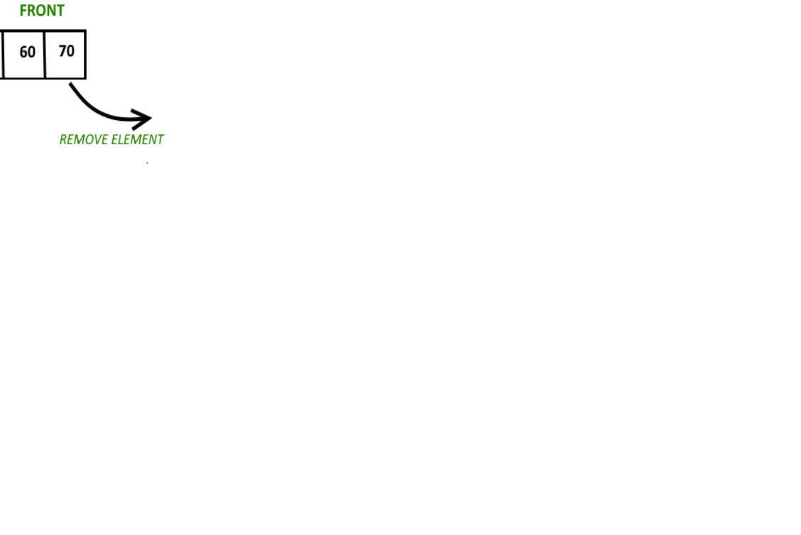
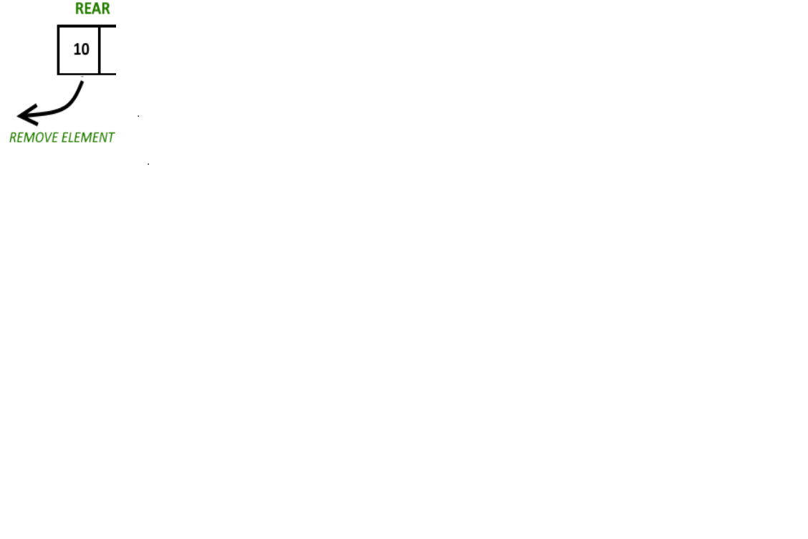

CODE IMPLEMENTATION
Clear the deque
Push Front
Adding an element to the front of the deque
Push Rear
Adding an element to the rear of the deque
Pop Front
Removing an element from the front of the deque
Removing an element from the rear of the deque
Clear
Pop Rear
isEmpty
Checking if deque is empty

Slide 11
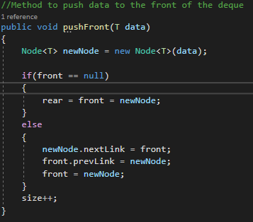
Push front

Slide 12
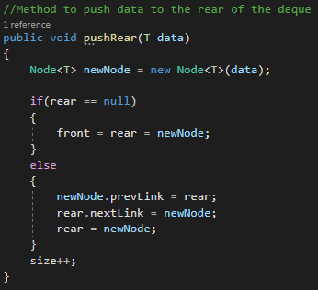
Push REAR

Slide 13
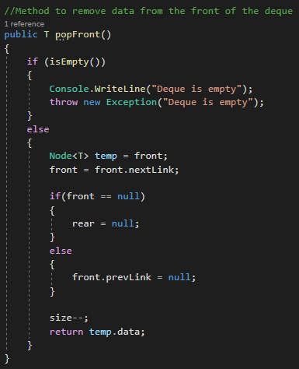
POP FRONT

Slide 14
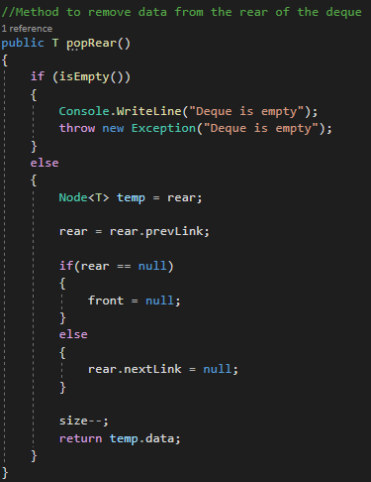
POP REAR

Slide 15
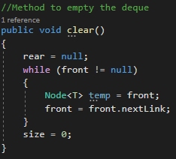
CLEAR

Slide 16
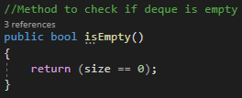
IS empty

Slide 17
SUMMARY
Deque is an abstract data type that generalizes a queue, for which elements can be added to or removed from either the front(head) or back(tail).
By having this capabilities, this data structure is not restricted by FIFO(First in first out) rule as in a stack or LIFO(Last in first out) rule as in queue.

Slide 18
THANK YOU
Sabrian Jufenlindo
1548517
Data Structures and Algorithms (Deque)

